Slide 1
STEM careers at Control Techniques

Slide 2
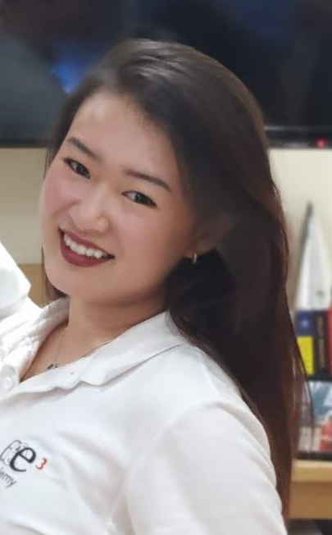
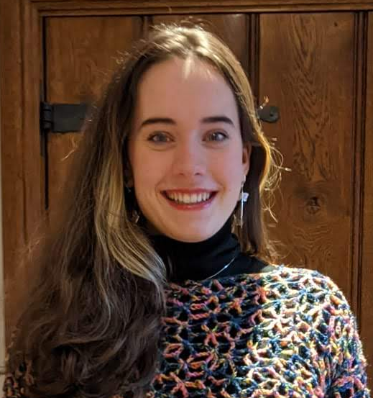
Hi!
Alex
Kitty
Graduate Engineers
Global Test Development
R&D Power Electronics
Machine Rig Design
Machine Program Software
Test Regulations
Power Electronics
EMC Testing and Design
PCB Layout
Notes:
Who are we? No-one may ever know <3

Slide 3
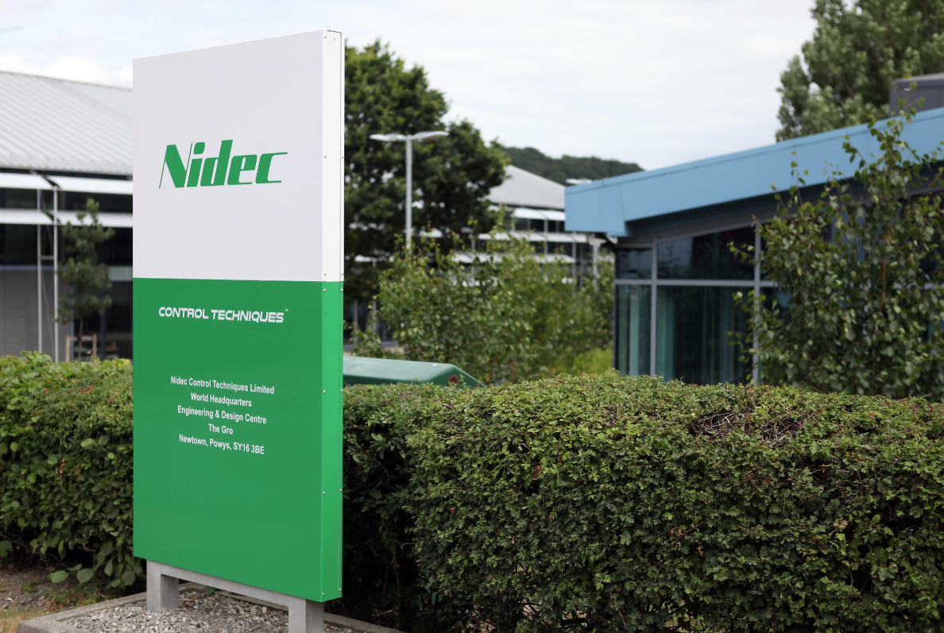
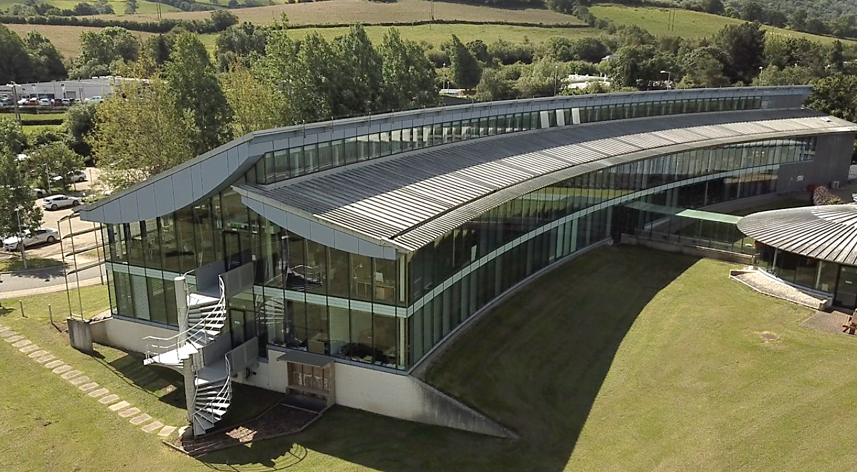
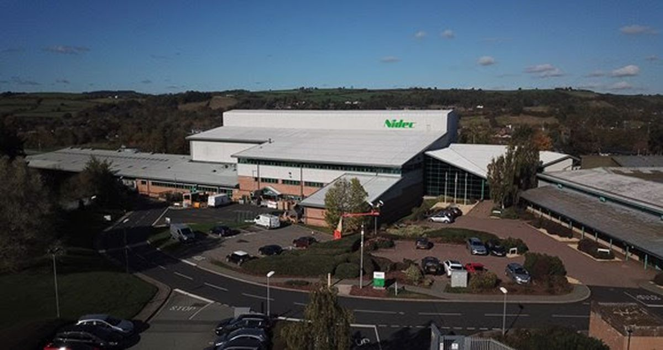
Where are we based?
Newtown, Powys
R&D Headquarters
Manufacturing plant
Notes:
Where do we work? Only half an hour away!
International centers also available

Slide 4

What do we do?
Notes:
https://www.youtube.com/watch?v=TllD5SkSirk- Check for ads!!

Slide 5

Engineering Sectors
Electrical
Electronic
Mechanical
Computing/Software
Firmware
Applications
Troubleshoot and Repairs
IT
Notes:
Electrical- big power, high voltage shenanigans
Electronic- small power, diddy voltage boards
Mechanical- how things fit together, physical movement of machinery
Computing and Software- Coding, programming routines
Firmware- Similar to software, interacting directly to control hardware of device e.g. operating systems
Applications- How to use the products efficiently
Troubleshoot and Repairs- problem solving
IT- computer systems, programs, cyber awareness(?)

Slide 6
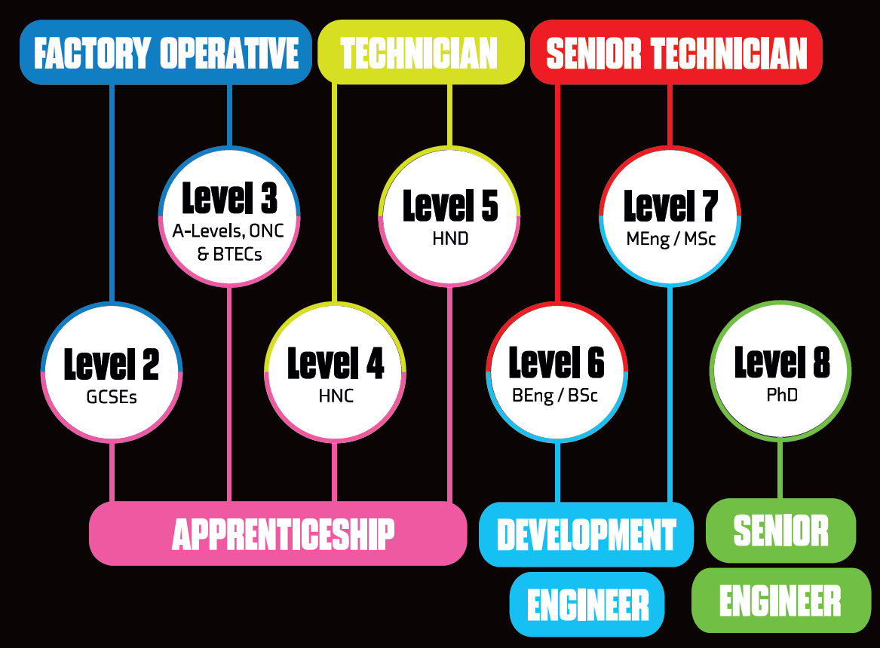
Career entry points
Notes:
This does not limit how far you can get!! This is only entry point to begin career path

Slide 7

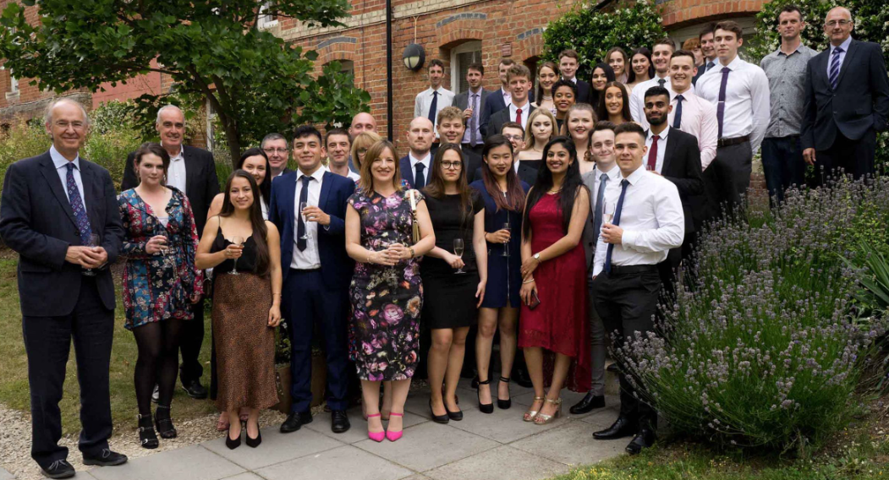
University Sponsorship Program
E3 Academy scholarship
£2500 annual bursary
£2500 annual 8 weeks paid summer internship
£6000 university fee reimbursement
Academy events and annual Summer School
University and Company mentors
Universities of Newcastle, Nottingham, or Bristol
Notes:
Big shmoney moves

Slide 8


Apprenticeship Program
Personalized experience rather than a generic academic plan; individually tailored to specific interests
Same timeframe for achieving qualifications, but alongside on-the-job training
Regular check-in meetings with manager/mentor/tutor
Earned salary instead of student fees/loans
Apprenticeship open days
Notes:
Also shmoney move but important experience too

Slide 9


Graduate Training Program
Internationally recognized IET accredited engineering graduate training program
Fast track path to personal and professional career growth
30% of Engineers in R&D currently achieved/pursuing CEng
6 month rotations for broader experiences

Slide 10
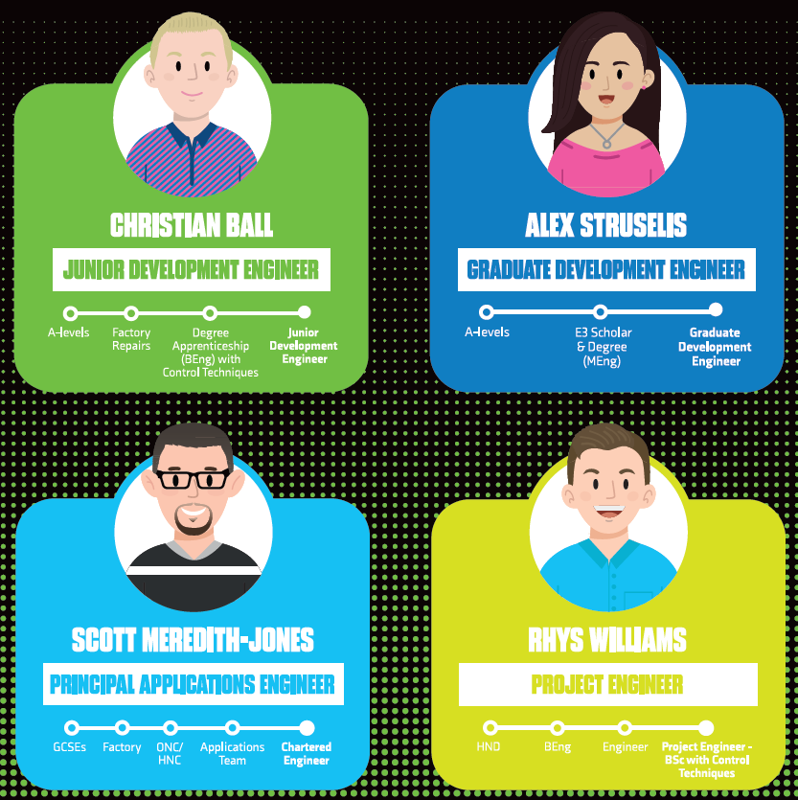
Example Journeys
Notes:
Alex- “classic” higher education journey
Rhys- A levels, HND, work instead of degree
Christian- A levels, work instead of uni
Scott- GCSEs, work instead of A levels

Slide 11
Our career journeys
Kitty
GCSEs
A Levels
University
German, French, Latin, History
Maths, Further-Maths, Physics, German
MEng Electrical and Electronic Engineering, Nottingham
E3 Academy Sponsorship
Final Project- Optics (A New Kind of Lens)
Alex
GCSEs
A Levels
University
History, Geography, French, Philosophy
English Language, History, Philosophy
MEng Electrical and Electronic Engineering, Newcastle
English Language, History, Philosophy
Maths, Physics, Systems and Control
E3 Academy Sponsorship
Final Project- Bioelectronic Prosthetics
Notes:
GCSEs- in addition to mandatory Maths, English and Science

